Slide 1

Object Oriented Programming
And Data Science
Workflows
In Python
McMedHacks Week 0-2
May 23rd, 2022, Monday
Instructor: Hunter Buckhorn

Slide 2
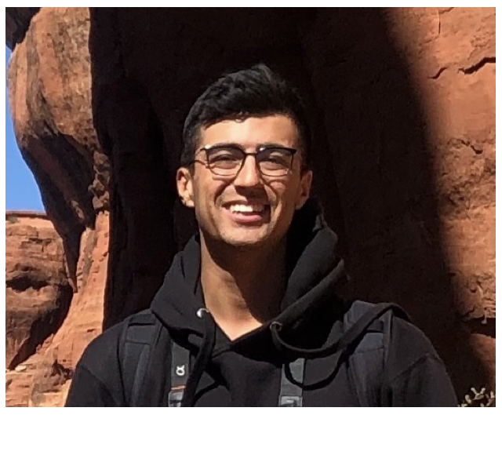
Instructor
Hunter Buckhorn
Machine Learning Engineer
Procore Technologies
Specialize in Math, Stats, and Computer Science
At University of California Santa Barbara
Current focus in Computer Vision applications in Construction:
Deep Learning:
Image Classification, Object Detection, Instance/Semantic Segmentation
OCR for document information extraction

Slide 3
Course Goals and Organization
Define Object Oriented Programming (OOP) and understand wider context in programming world
Concepts:
Classes and Objects (Review)
Intro OOP and Class Design for computer vision data
Encapsulation
Inheritance
Polymorphism
Data Abstraction
Finally: Data Science! Let’s relate OOP concepts to the Data Science workflow

Slide 4
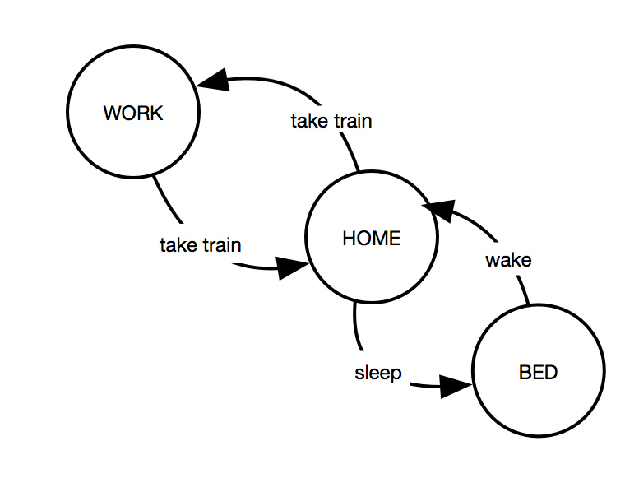
History Lesson
Turing Machines!
Represented a “state” and a set of transitions and rules
First implementable abstractions
Notes:
Turing Machine 1936

Slide 5
History Lesson
History Lesson: Programming environment in the 40s and 50s and programming paradigms
Theory and formulation of a computer first implementations on hardware. First popular “high-level” languages: Lisp, fortran, cobol, C-based!
Imperative programming evolving towards procedural programming
Focus on the “state” of a program -> relationship to state machines
How to organize the state changes with functions?
Functional programming
Application of functions and compositions, declarative programming -> relationship to state machines
Stateless! Where are the variables?
Notes:
Turing Machine 1936

Slide 6
History Lesson
History Lesson:
Theory of computations and the Turing Machine
Machine Code 0101100100101100
Assembly Language $a2 = $a2 + $a6
Fortran (compiled language: variables, expressions, subprograms)
ALGOL (applications of mathematical formulas)
COBOL + BASIC (more human readable)
Pascal / Lisp (imperative + procedural, allowed for better practices)
C and C++
Perl
Python
Notes:
Turing machine 1936
Vacuum computers 1939!
WW2 ENIAC used to calculate for hydrogen bomb. Programmed it with plugboards and switches!
IBM 650 first mass produced computer 1953, programmed with punch cards! Weighed 6000 pounds only 35 kilobytes of memory (4000 words)
C: Dennis Ritchie, Bell labs 1972-73. Low level language to interact with the kernel. Compiled language, typed, supports structured programming and code organization
Perl: automatic memory management, dynamic typing (designer, Wall, was trained as linguist -> led to a more natural language)
Python: Guido van Rossum: 1980s includes all paradigms! Dynamically typed, auto-mem management

Slide 7
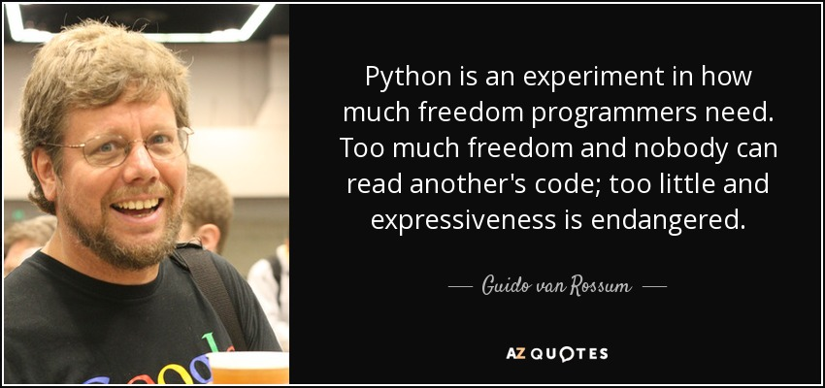
Python Design Motivation
Guido Van Rossum
Small core language: large stl, extensible
Integration: lot of libraries for each domain / use case
`The Zen of Python` (PEP 20)
Simple syntax
Obvious way to do it
Support for other paradigms!
https://peps.python.org/pep-0020/

Slide 8
Python OOP
Python treatment of objects:
“One of my goals for Python was to make it so that all objects were "first class." By this, I meant that I wanted all objects that could be named in the language (e.g., integers, strings, functions, classes, modules, methods, etc.) to have equal status. That is, they can be assigned to variables, placed in lists, stored in dictionaries, passed as arguments, and so forth.”
Van Rossum

Slide 9
Data Abstraction
One of the tenets of OOP:
Data Abstraction in Python:
Abstraction in python is defined as a process of handling complexity by hiding unnecessary information from the user.
Once of the core concepts to drive object oriented programming

Slide 10
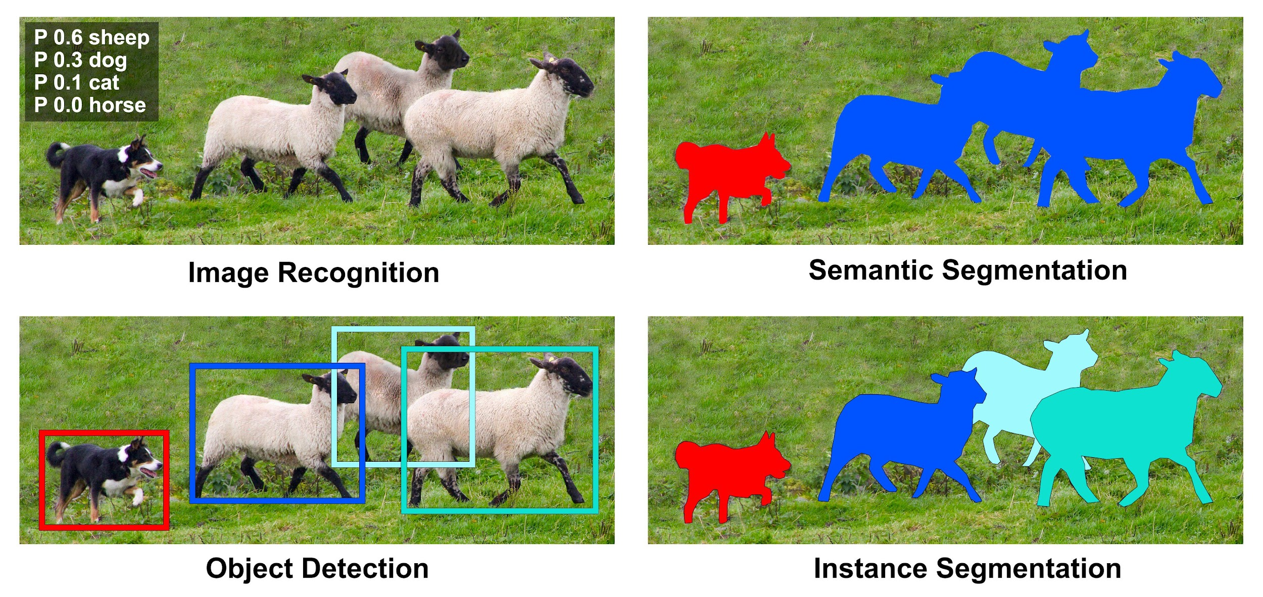
Classes / Objects
A class is a collection of data and functions -> “attributes” and “methods”
How to map a concept in computer vision to a meaningful class design?

Slide 11
Attributes
Images:
Image name / id(s)
Image absolute file path
Image dimensions: (height, width, channels)
Image metadata (exif)
Annotations:
The label of the object
The location of the object
Relationship to image and groups of labels

Slide 12
Methods
Operations on Images and Annotations:
Resizing
Cropping
Padding
Operations for photo editing and computer vision:
Adding brightness to images
Adding contrast
Snapchat filters :)
https://github.com/albumentations-team/albumentations
https://github.com/aleju/imgaug
Notes:
Move to google colab to define the image and annotation class

Slide 13
Polymorphism
Definition:
The word polymorphism means having many forms. In programming, polymorphism means the same function name (but different signatures) being used for different types.
Applications to our data?
Notes:
Want to create a collection of our data points which can act like a list

Slide 14
Polymorphism
Functions of Images and Annotations:
Can get the size
.size()
Can resize:
.resize()
Other operations?
Can read and write files
.read()
.save()
Notes:
Want to create a collection of our data points which can act like a list

Slide 15
Encapsulation
Definition:
Wrapping data and the methods that work on data within one unit. This puts restrictions on accessing variables and methods directly and can prevent the accidental modification of data. To prevent accidental change, an object’s variable can only be changed by an object’s method.
Applications to our data?

Slide 16
Encapsulation
Organization of images and annotations:
Image class
Annotation class
Data point class -> representation of the relationship between both ^
Image object
Annotation object(s)
Attributes on the collection
Methods on the collection

Slide 17
Inheritance
Definition:
Inheritance allows us to define a class that inherits all the methods and properties from another class.
Parent class is the class being inherited from, also called base class.
Child class is the class that inherits from another class, also called derived class.
Applications to our data?
Notes:
Want to be able to apply the same operations to both the image and the masks, same attributes etc

Slide 18
Inheritance
How to identify opportunities for inheritance
Think about common attributes and methods: What do both classes have in common?
Think about the natural taxonomy of your real world object
Vehicle -> car -> suv -> 4runner -> your 4runner
Images and Annotations?
Both 2 dimensional so all transformations on 2d geometry apply
Can define a common base class for 2d objects, implementing these operations and attributes. Then our image class and annotation class can inherit from it

Slide 19
Polymorphism
Definition:
The word polymorphism means having many forms. In programming, polymorphism means the same function name (but different signatures) being used for different types.
Applications to our data?
Notes:
Want to create a collection of our data points which can act like a list

Slide 20
Polymorphism
Our data point class:
Now that we have a single data point object, we should be able to group and work with a collection of data points and have common attributes and operations
How to extend a single data point to a collection of data points?
Think about python lists and dictionaries….
What do we want to keep track of in a collection of data points?
Important attributes and methods for our concept of a dataset?
Notes:
Want to create a collection of our data points which can act like a list
How about resize entire dataset?
What are the supported labels?

Slide 21
Polymorphism
Dataset: Collection of data points
File formats
Images and metadata
Annotations and metadata
File system information
Id for relationship between dataset and pipeline configuration
Datasets:
Training
Validation
Test / QA sets
Notes:
Polymorphism between different datasets:
Can run inference on each set
Can record metrics on each set
Can visualize each set
Can visualize predictions on each set
Can get image stats or annotations stats on each set
Can have humans QA predictions on each set

Slide 22
Inheritance and Polymorphism in Data Science
Data and Data Transformations
Model Development
Evaluations
Examples of Inheritance and Polymorphism for common classes:
Common data types:
Filetypes and objects during runtime
Model architectures:
Backbones
1 stage / 2 stage, etc
Evaluation metrics:
Losses / metric calculations and displays
Notes:
Want to create a collection of our data points which can act like a list
How about resize entire dataset?
What are the supported labels?

Slide 23
OOP and Functions
If we think about the concepts defining OOP we can consider how they can be related to functional programming in python…
Bear with me…
By thinking of these concepts we can create a clean workflow for using functional programming techniques and also avoid “code smells”
Encapsulation -> create clean interfaces for your function concepts
Inheritance -> identify any commonalities in your functions
Polymorphism -> how can different functions have similar use cases?
Data Abstraction -> create abstractions for sets of function applications
Notes:
Want to create a collection of our data points which can act like a list
How about resize entire dataset?
What are the supported labels?

Slide 24
Functional Python
In addition to these OOP concepts in python, another useful paradigm that is common in data processing is core functional programming: map and reduce
Lambda
The holy grail: Map, Filter, Reduce
Custom functions and pandas
Itertools
Every kind of iteration imaginable
Defaultdict
Defining function IO and apis
Set logic
Working with data points and the filesystem

Slide 25
Managing State and Transforms
In data science, organization of input and output as well as organization of functions and their params is very important for recording experiments and for reproducibility
Keep track of our steps!
Keep track of datasets
Keep track of the params for each function application (config files)
Keep track of the input and output required to reproduce set of steps taken

Slide 26
Data Science Example
Code Pairing
Lets implement an image-annotation class and extend it to a dataset

